Slide 1
Data science framework

Slide 2
AGENDA
Case study overview
Data science process

Slide 3
Case study
Crude oil price prediction
Called “black gold”
Key commodity of the world’s economy
Many other factors like Gross Domestic Production growth, stock levels inventories, foreign exchange rates, world population, political aspects and investors‟ expectations can significantly affect the price of oil.
the time to ship crude oil from one country to another can affect directly their price because oil prices vary in different regions of the worldwide.
The oil price fluctuations have a direct effect on the nation‟s economy
therefore, it is of vital importance to predict oil price.

Slide 4
Data science Process

Slide 5
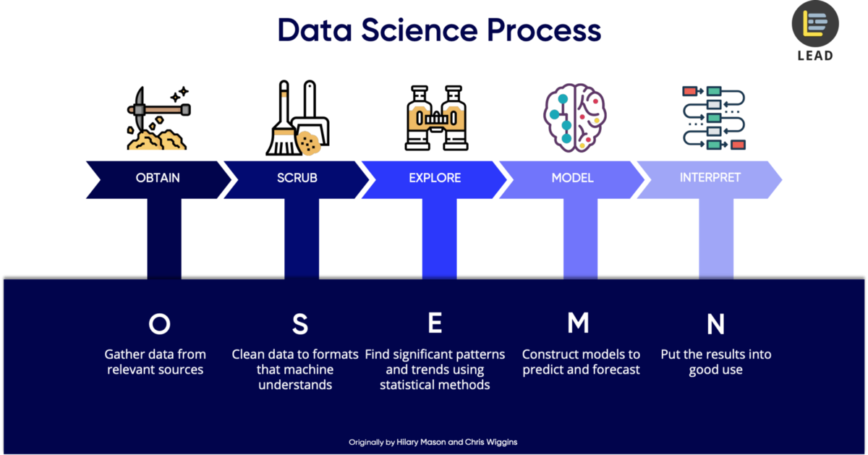
​​​

Slide 6
Data science Procress
Machine learning
OBTAIN
SCRUB
Data cleansing
Examine data
MODEL
EXPLORE
Get data from Kaggle from March 1983-September 2022
INTERPRET
Convert data if needed
Split or merge data
Replace if data appears non-values or missing data
Use Python
Use python library: Sci-kit learn, numpy, matplotlib
Numerical data
Use data visualization like matplotlib, ggplot
Time series chart
Use Neural network GARCH/LSTM model
Find outlier with boxplot
Use Python

Slide 7
THANK YOU
https://towardsdatascience.com/5-steps-of-a-data-science-project-lifecycle-26c50372b492

